Slide 1

Cyclistic Bike-Share Analysis
How members and casual riders behave — and how to convert casuals to annual members
By: Farhan Deshmukh

Slide 2

Business task
Objective
How do annual members and casual riders use Cyclistic data differently?

Slide 3
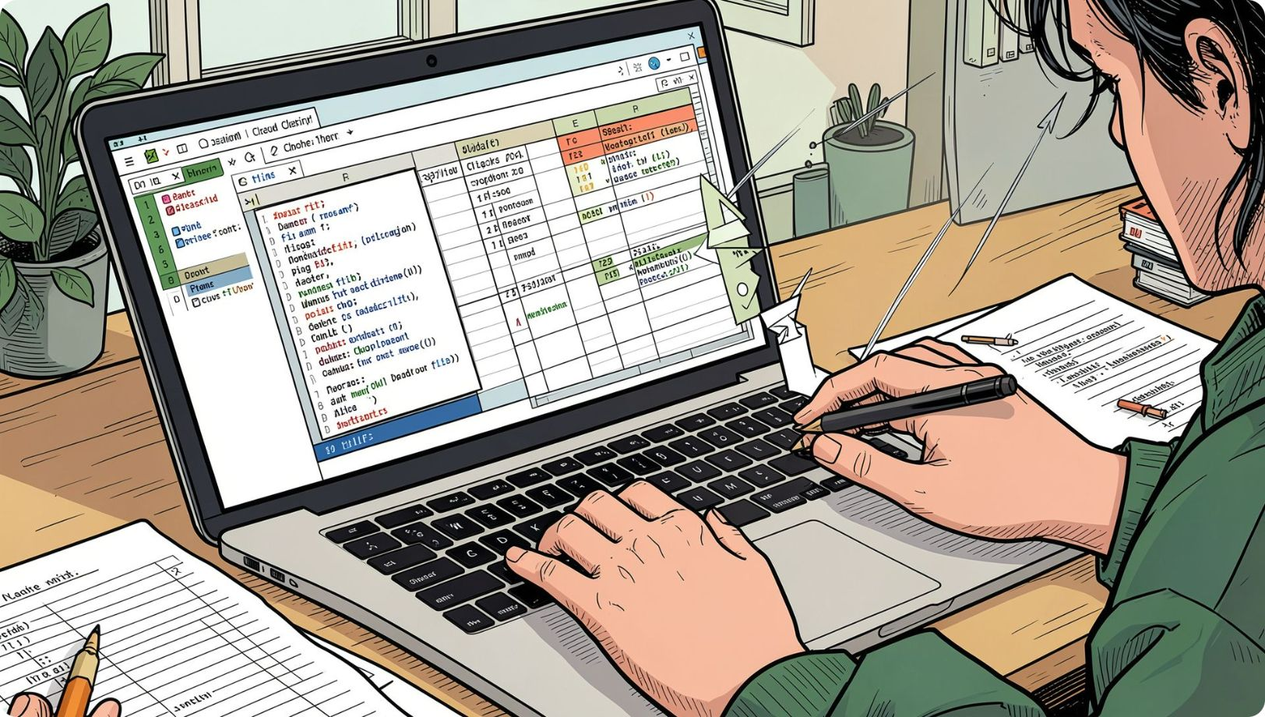
Data Preparation & Cleaning
Dataset: last 12 months of Cyclistic trip data
Removed some unwanted geo coordinates columns
Checked missing values
Convert the datatypes of some columns that are not right
Created new columns like ride_length & week days
Identified and removed negative ride lengths
0

Slide 4

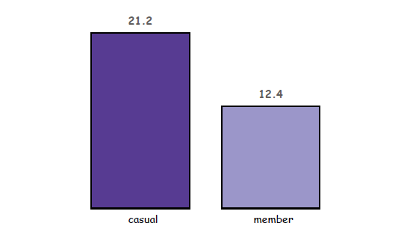
Average ride length
Casual vs Member
0

Slide 5
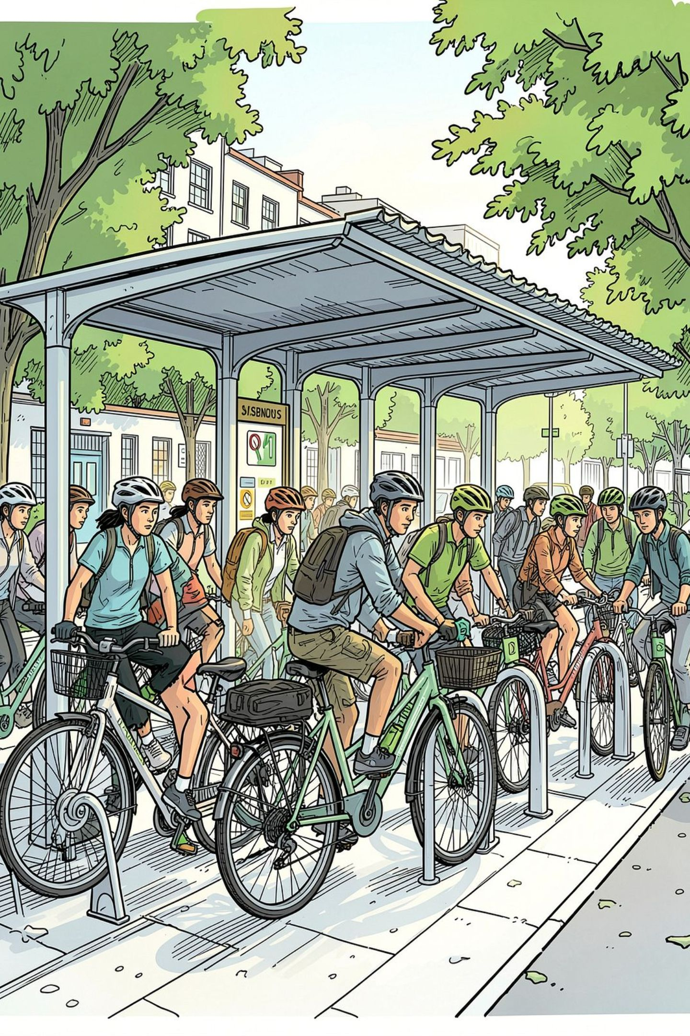
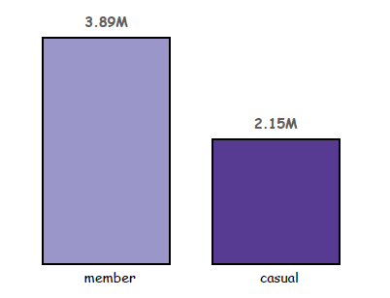
Total rides — Casual vs Member
Difference: ~1.74M rides

Slide 6

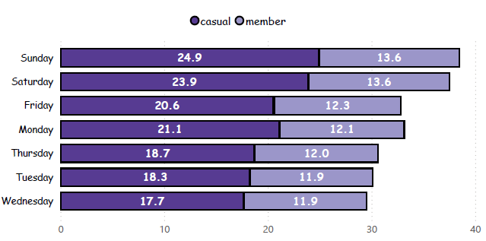
Ride length by day
Casual riders tend to have longer ride durations on weekends than on weekdays.
Member ride durations remain consistently lower than casual rides.

Slide 7
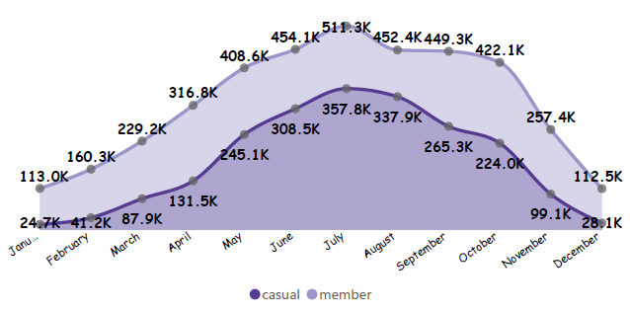
Monthly ride trends
Casual riders:
Casual riders show higher ride volumes during the summer months.
Member riders:
Member riders also show higher ride volumes during the summer months.
Overall:
Both rider groups see their highest ride volumes during summer.

Slide 8




Key findings
1. Casual rides are longer
2. Members ride more often
3. Seasonal casual surge
4. Weekends= longer trips

Slide 9
Recommendations
1. Weekend membership offers
Time-limited discounts aimed at casuals who take long weekend rides
2. Promote value for frequent casuals
Highlight cost-per-ride savings for multi-hour / repeated users
3. Targeted ads at leisure hotspots
Geo-target tourists and park-area riders with membership trial offers

Slide 10
Conclusion
Cyclistic has an opportunity to convert casual riders into annual members.
Casual riders take longer rides, showing strong engagement with the service.
Members take more rides, showing the value of regular usage.
Different riding patterns provide opportunities for targeted marketing.
Weekend and seasonal patterns can help Cyclistic time its membership campaigns.

